Slide 1

Retail Business Analytics using SQL
PROJECT OVERVIEW
Tool & Technologies
This project focuses on solving real-world business problems in a retail environment using advanced SQL techniques. The goal is to transform raw data into meaningful insights that support strategic decision-making and improve overall business performance.
SQL
My SQL
DATASETS USED
Sales_data
Contains order details, sales, porfit, product information, etc.
Customer_details2
Contains customer demographics, segment, city, region details, etc.
Business_operations
Contains operational data like costs, payment and order status.
KEY BUSINESS AREAS COVERED
PROJECT HIGHLIGHTS
Solved 20+ real-world business scenarios using advance SQL.
Used complex SQL concepts: JOINs, CTEs, Subqueries, Window Functions, Views, Aggregations.
Built queries for actionable insights and performance tracking.
Designed for scalability and real-world business use.
Revenue Analysis
Sales Performance
Customer Lifetime Value
Funnel
Analysis

Slide 2
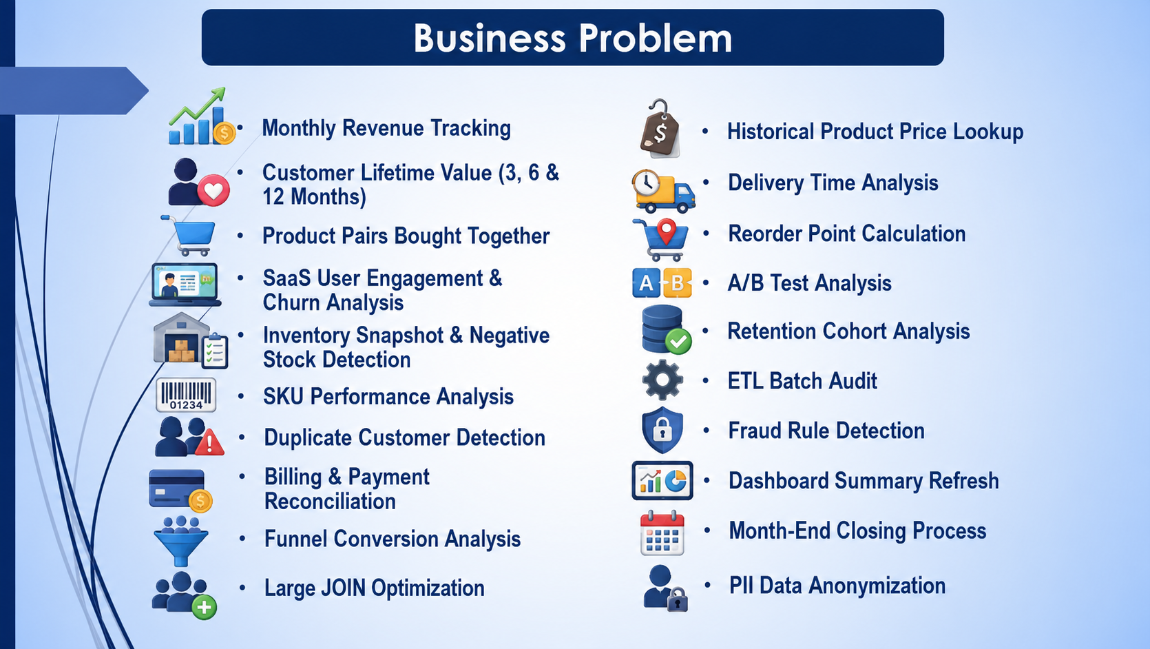

Slide 3
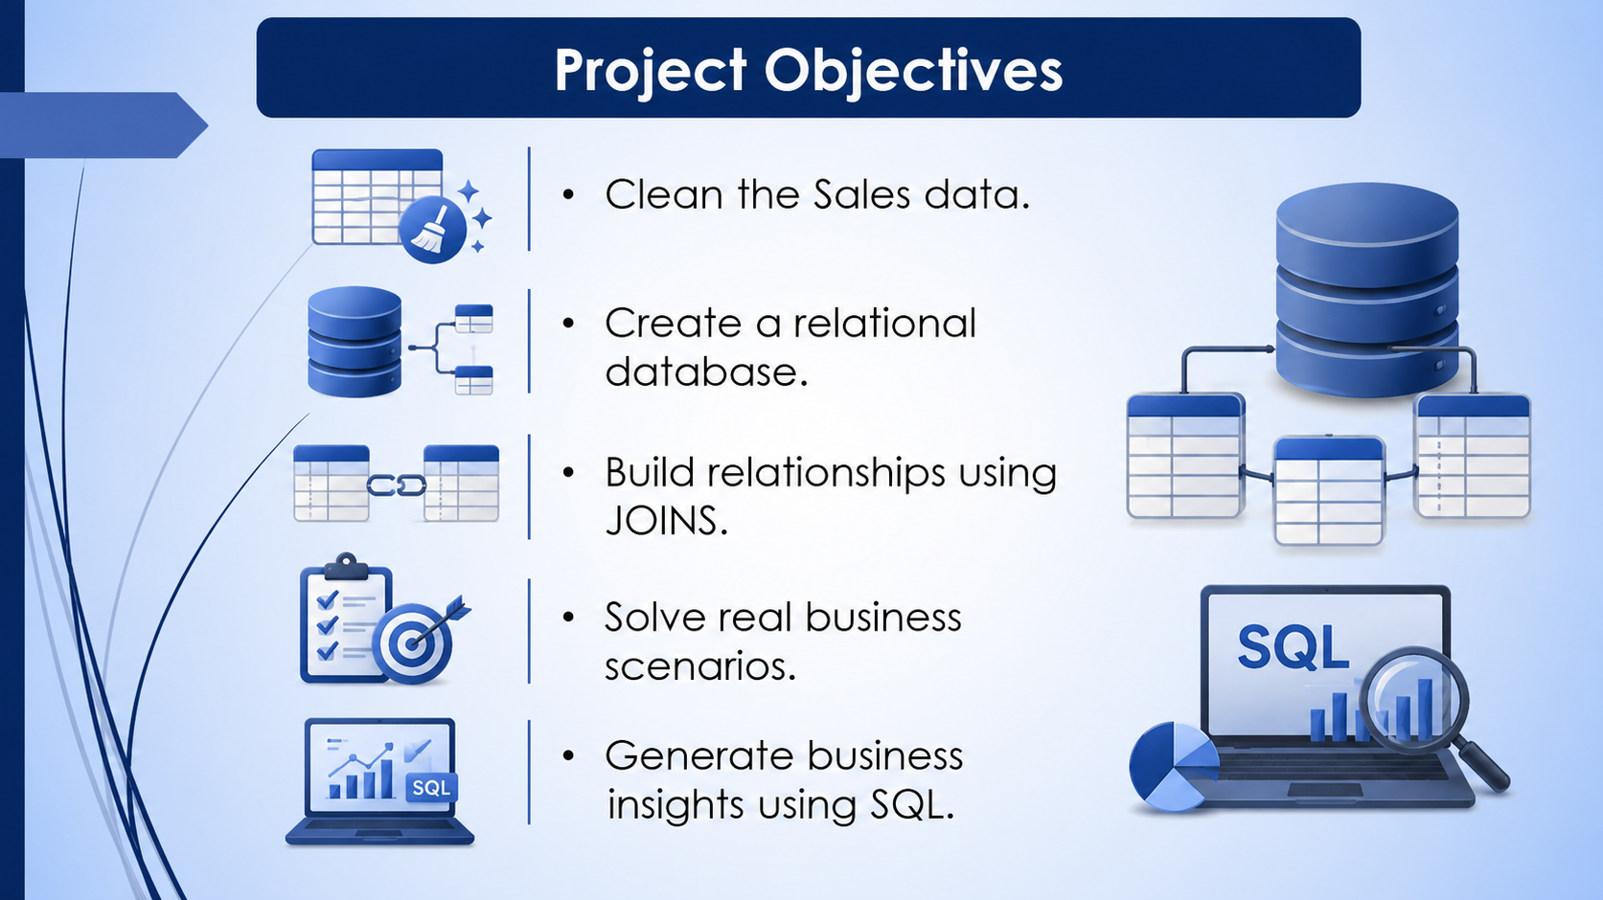

Slide 4
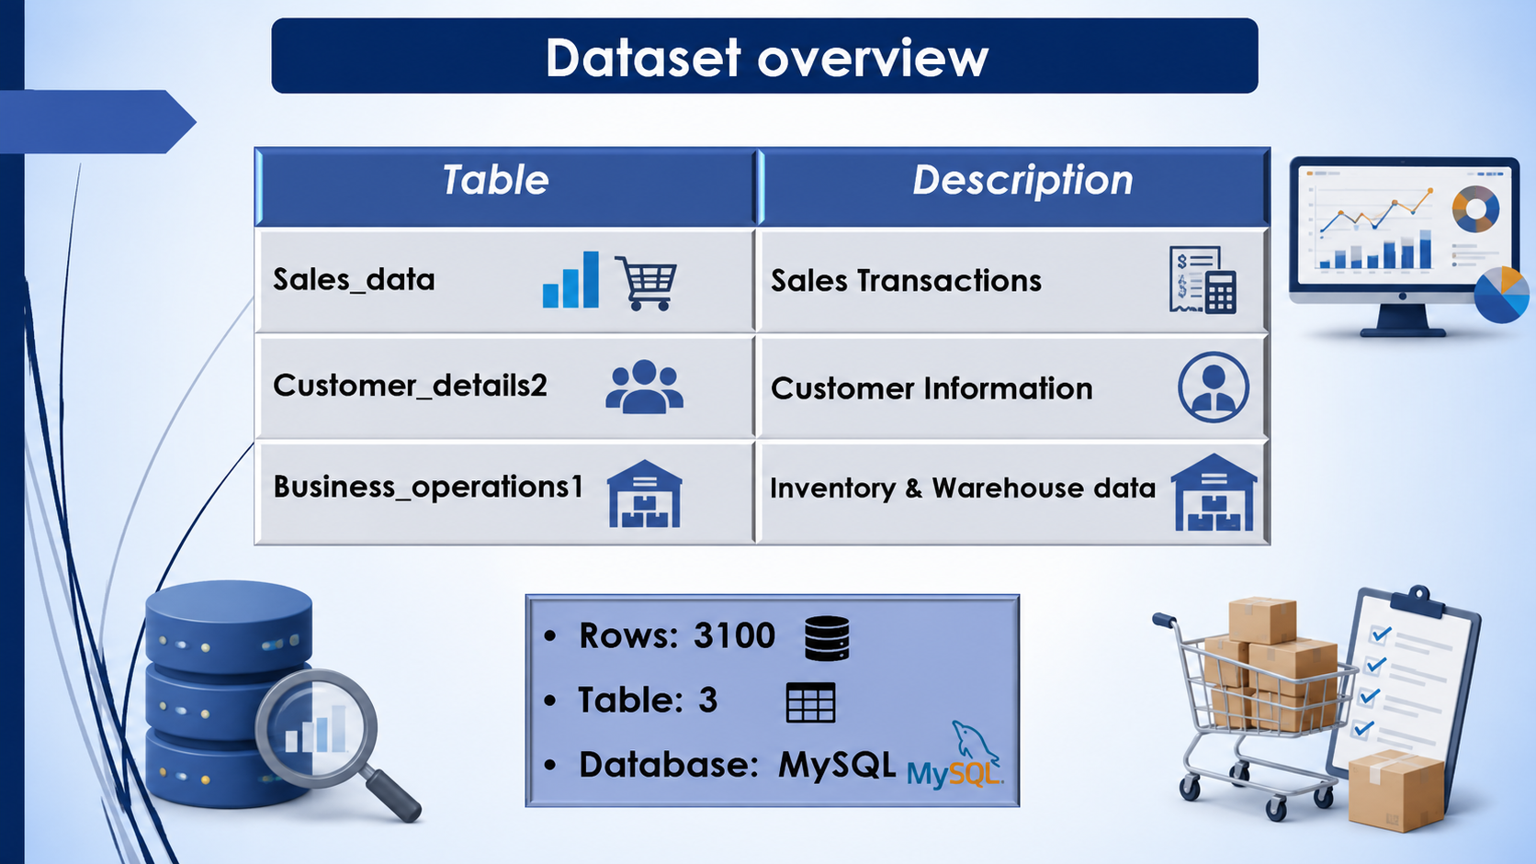

Slide 5
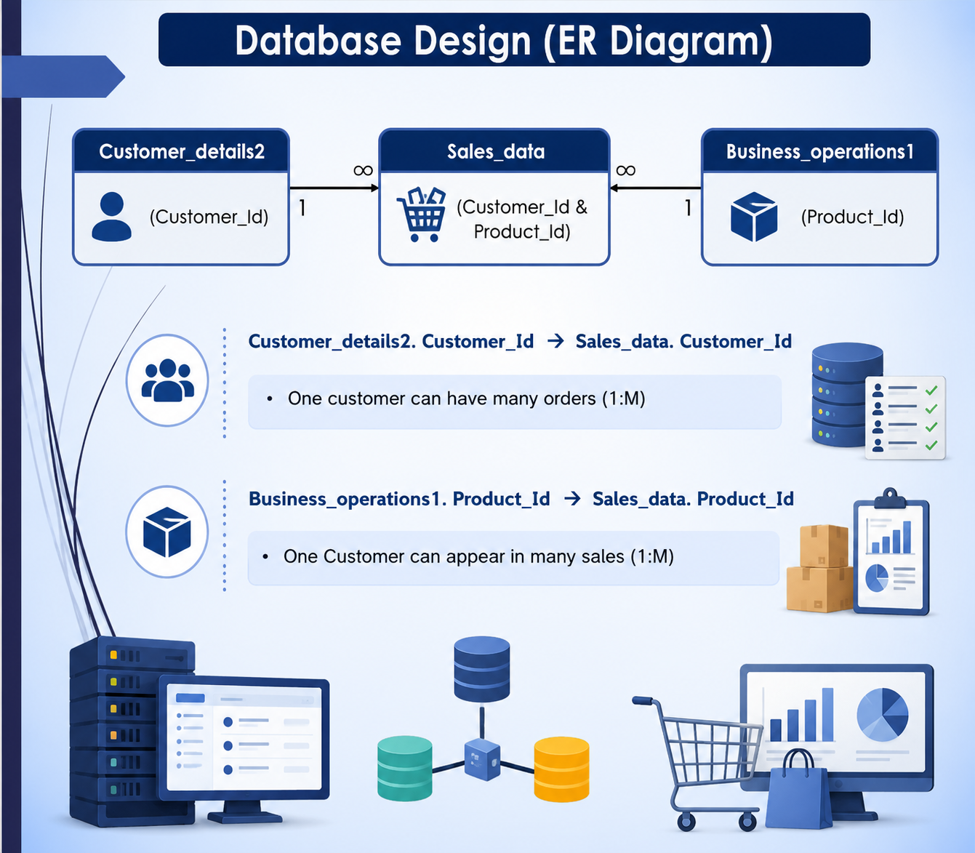

Slide 6
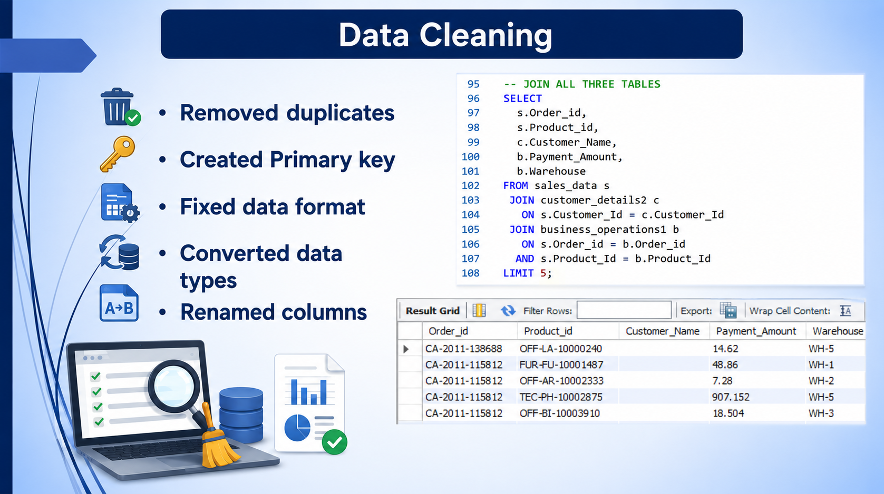

Slide 7
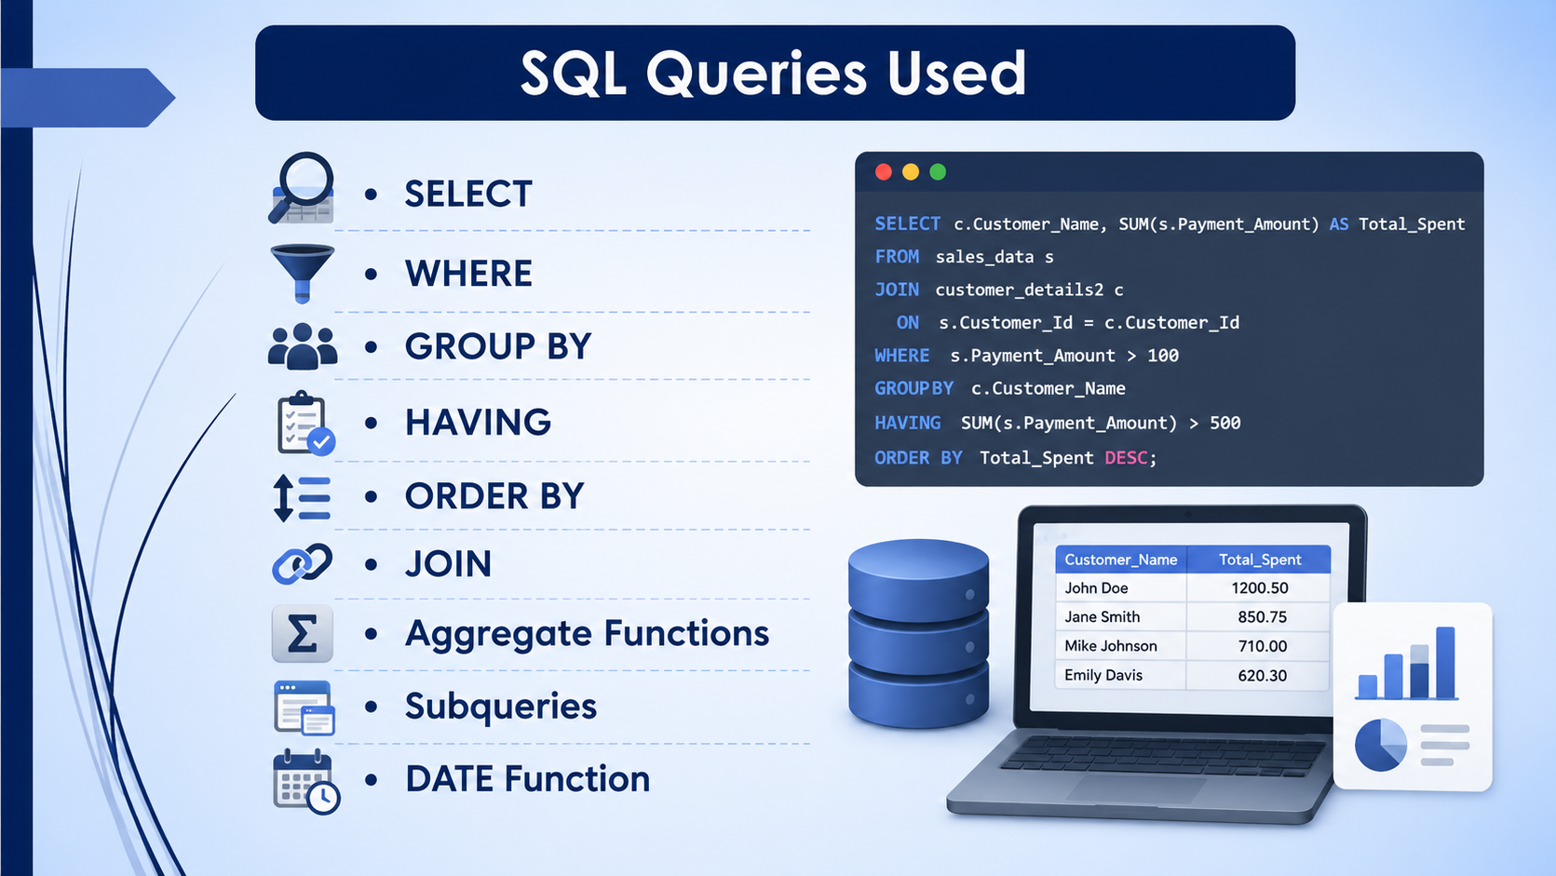

Slide 8
Monthly Revenue Tracking
Scenario 1
How much revenue were generated each month
How many orders were placed each month
What was the average order value
Which months experienced a revenue drop of more than 10% compared to the previous month
Which month require immediate business attention
KPI | Formula
Monthly Revenue | SUM(Sales)
Total Orders | COUNT(DISTINCT Order_Id)
Average Order Value | Revenue/Order
Previous Month Revenue | LAG(Monthly Revenue)
Revenue Growth% | (Current-Previous)/Previous)*100
Revenue Drop Alert | Growth<-10%
This report will be presented to the CEO every month to evaluate business performance and make decisions about pricing, promotions, inventory, and marketing.

Slide 9
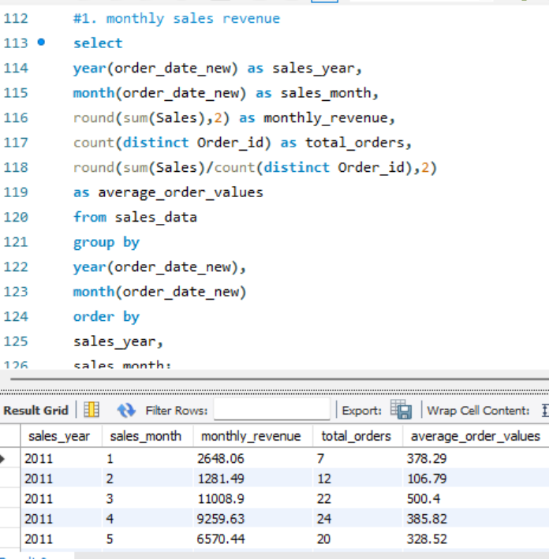
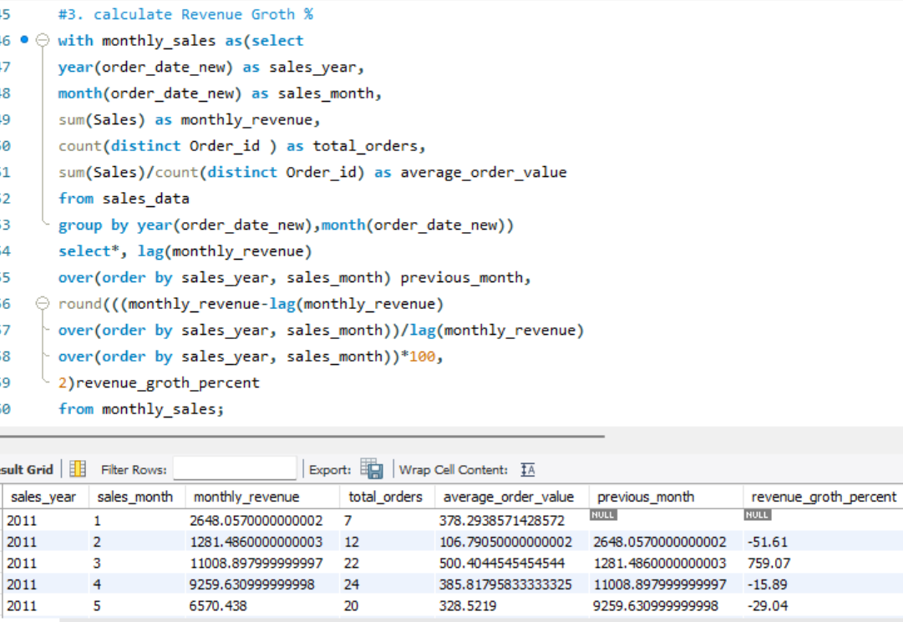
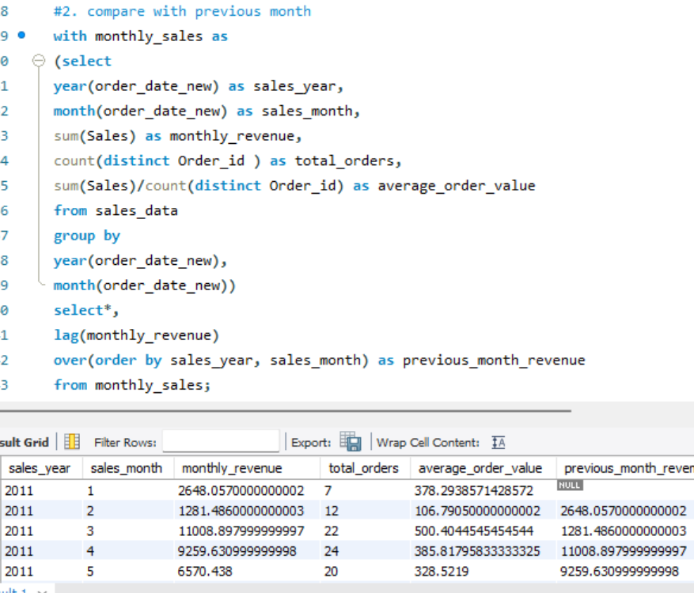

Slide 10
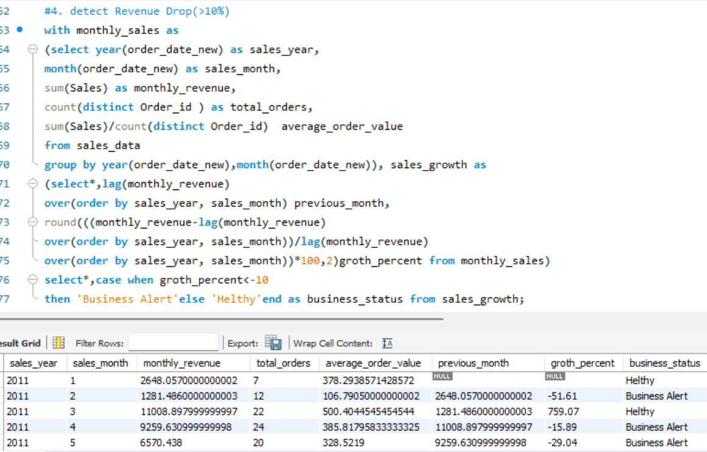
Business Insights
Revenue Dropped 13.32% In March, Exceeding the 10% threshold.
Average Order Value decreased in March, indicating customers spent less per order.
The Sales team should investigate whether discounts, product availability, or seasonality contributed to the decline.
Marketing campaigns and inventory planning should be reviewed before the next comparable period.

Slide 11
Customer Lifetime Value
Scenario 2
Use –
JOIN between 2 tables(Sales_data and Customer_details2)
Aggregate function (SUM)
Corelated subquery,
Date function.
Which customer spend the most
How much revenue each customer generated in the first 3,6,12 months after singing up
If a customer returns an order, treat that amount as negative revenue
The company considers returned orders as negative revenue because they reduce the customer’s actual value.

Slide 12
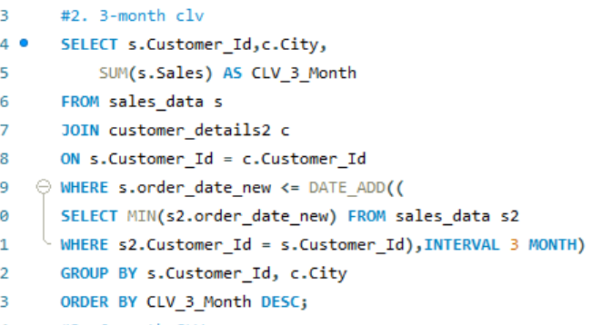
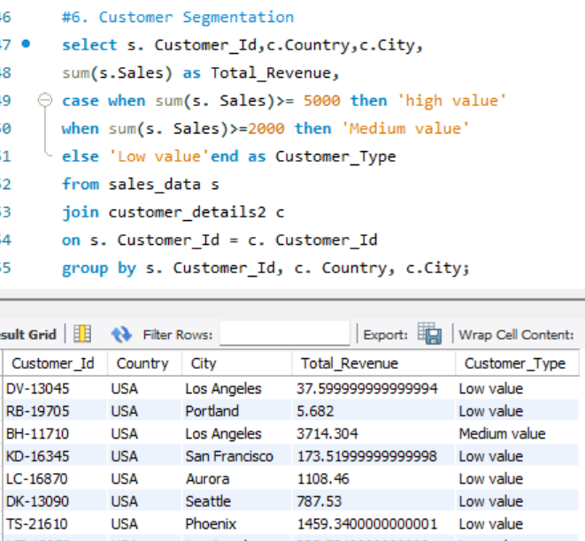
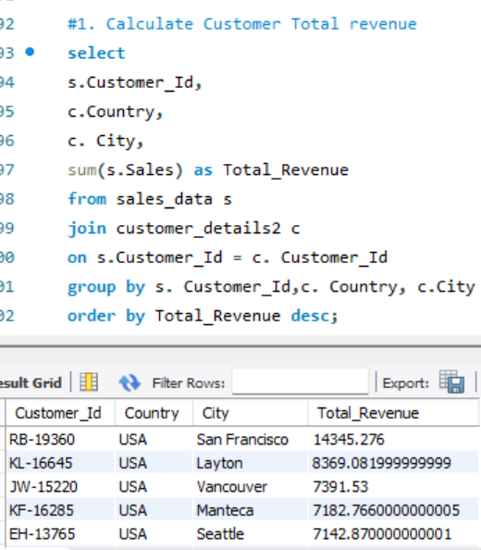
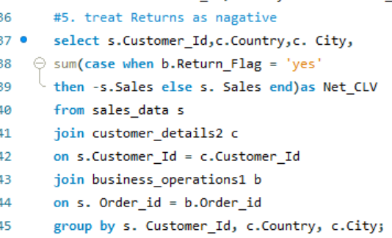
Customers with the highest 3-month CLV are strong early buyers and should receive loyalty rewards.
Comparing 3, 6, and 12-month CLV helps determine whether customers continue purchasing over time.
Cities with higher CLV indicate stronger customer loyalty and higher market potential.
Customers with low CLV may require targeted promotions or engagement campaigns to encourage repeat purchases.

Slide 13
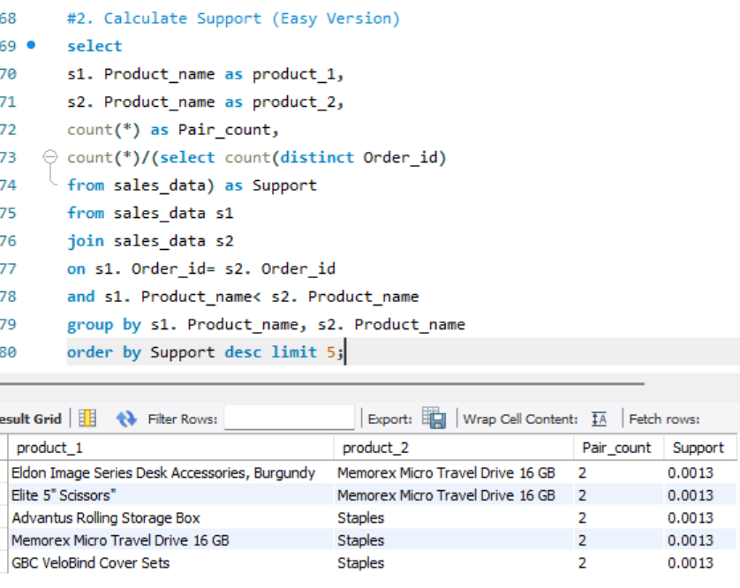
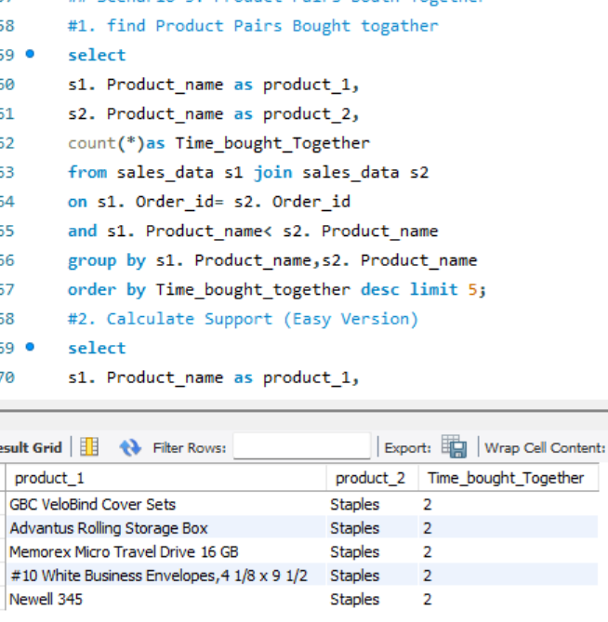
Product Pairs
Calculate Support(Easy Version
Product Pairs Bought Together
Scenario 3
Helps marketing teams create combo offers.
Powers “Frequently Bought Together” recommendations.
Increases average order value through cross_selling.

Slide 14
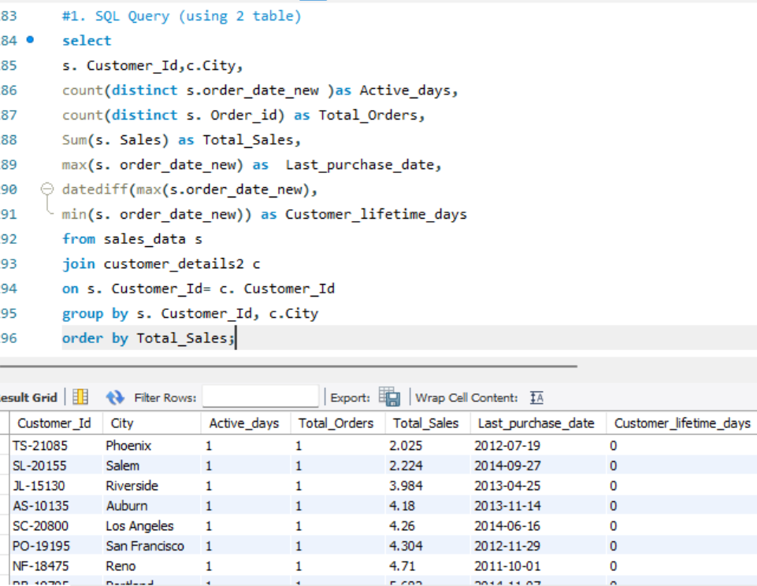
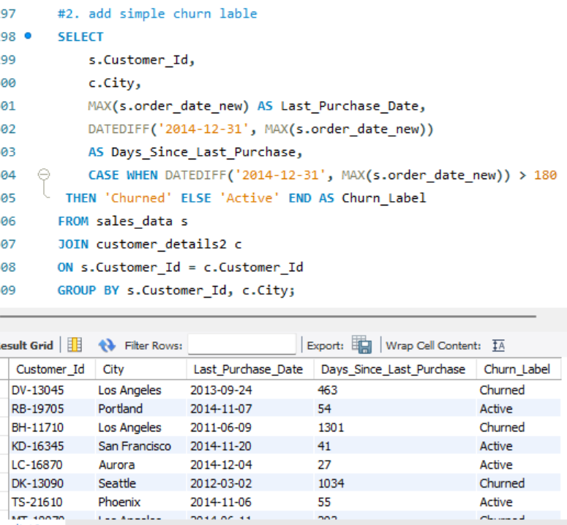
SaaS User Engagement Features
Scenario 4
Customers with more active days are more engaged.
Customers with high total sales are high-value customers.
Customers whose last purchase was a long time ago are at risk of churn.
The business can target churned customers with personalized discounts or email campaigns to encourage repeat purchases.
JOIN, GROUP BY, Aggregate functions & CASE Statement

Slide 15
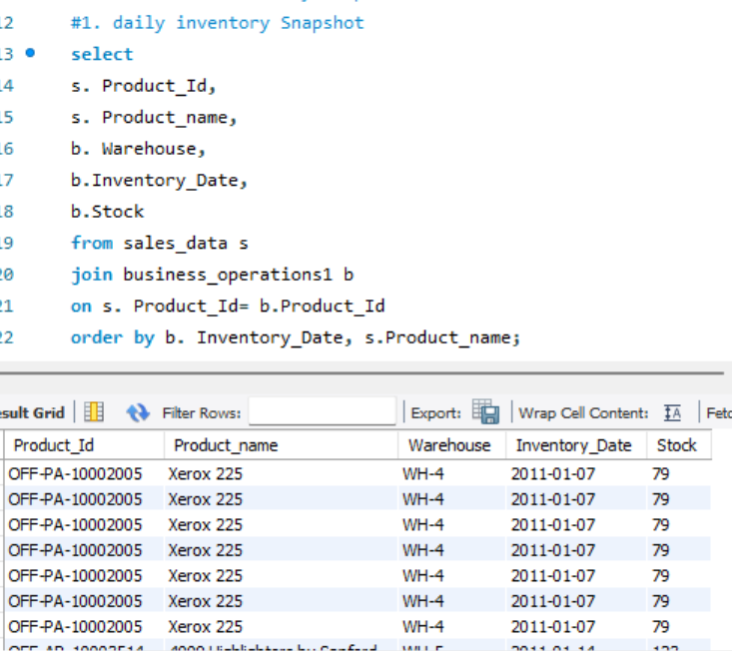
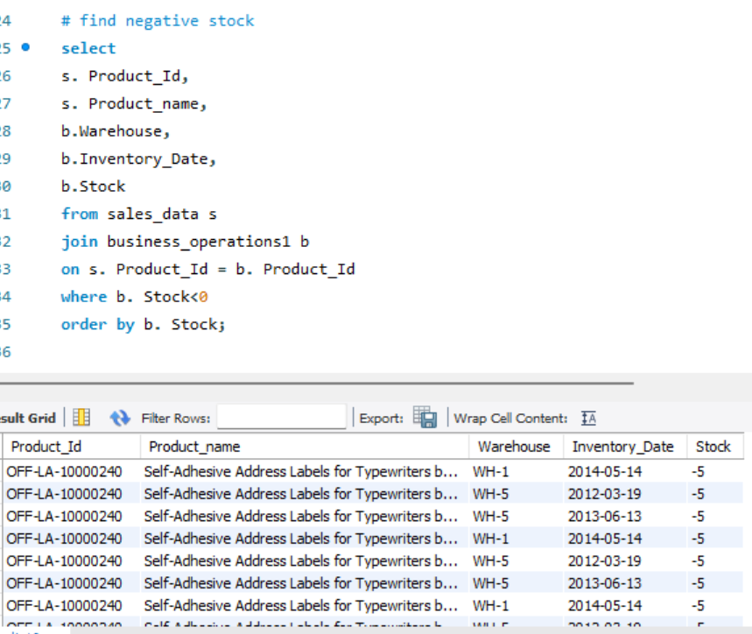
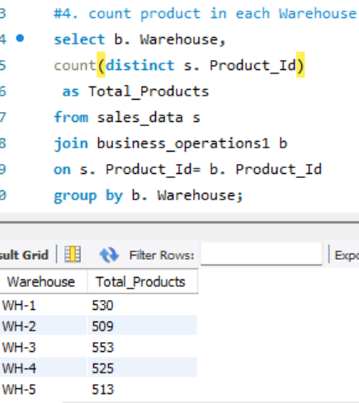
Inventory Snapshot
Scenario 5
Products with stock below 20 should be reordered immediately to avoid stockouts.
Negative stock values indicate inventory issues that require investigation.
Warehouses with low average stock may need additional inventory transfers or purchases.
Daily inventory snapshots help warehouse managers make faster replenishment decisions and maintain product availability.

Slide 16
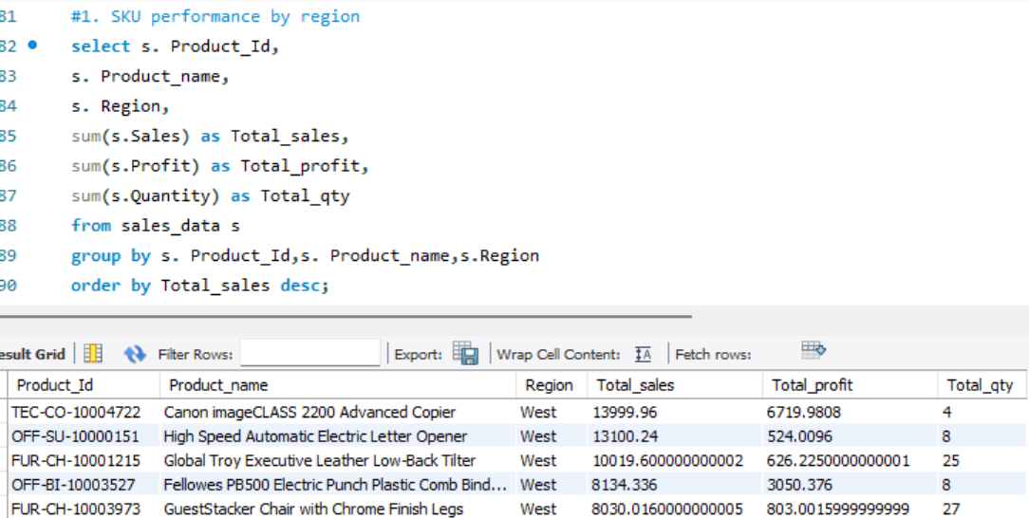
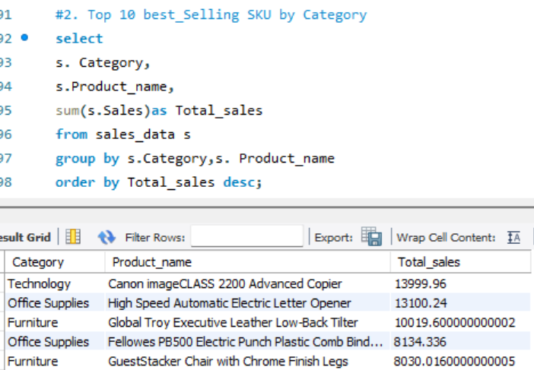
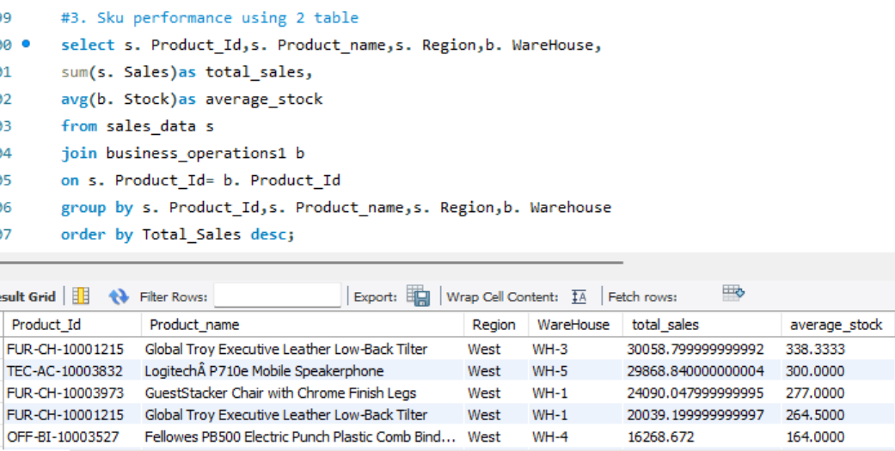
SKU Performance by Region
Scenario 6
The top-selling SKUs contributed the highest share of total revenue and should be prioritized for inventory replenishment.
Some products generated high sales but relatively low profit, indicating the need to review pricing or operational costs.
A few SKUs showed low sales performance, suggesting they may require promotional campaigns or inventory reduction.
Product categories with consistently high-performing SKUs should receive additional marketing and stocking support.

Slide 17
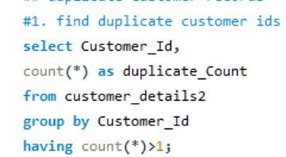
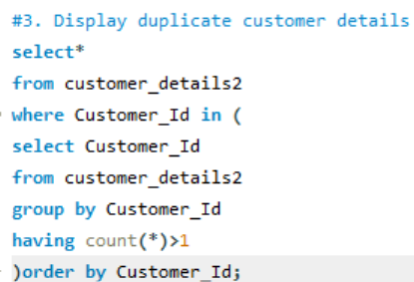
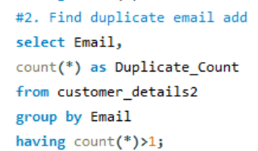
Duplicate Customer Records
Scenario 7
Duplicate customer records can lead to incorrect customer counts and inaccurate business reports.
Customers with duplicate contact information may receive multiple promotional emails or notifications.
Duplicate records can affect Customer Lifetime Value (CLV) and sales analysis.
Merging duplicate records improves the accuracy of customer analytics and reporting.

Slide 18
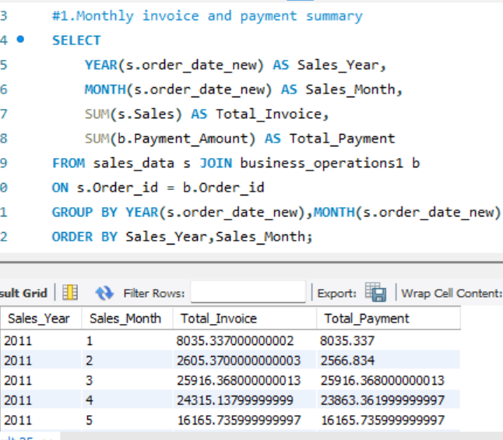
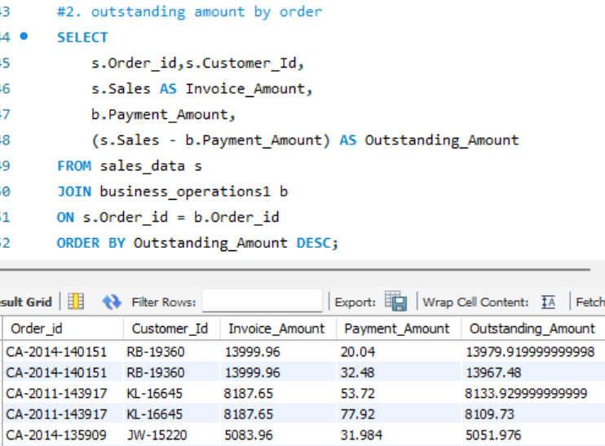
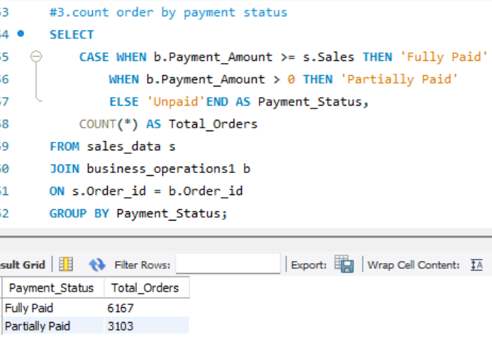
Billing Reconciliation
Scenario 8
Most invoices were successfully reconciled with customer payments.
Partially paid invoices indicate customers with remaining balances that require follow-up.
Unpaid invoices increase the company's outstanding receivables and may negatively impact cash flow.
Monthly billing summaries help the finance team monitor payment trends and collection performance

Slide 19
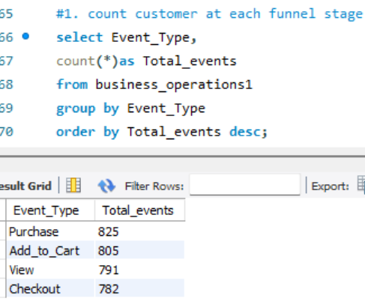
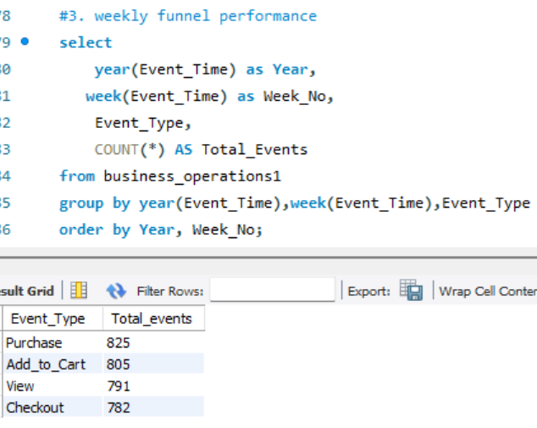
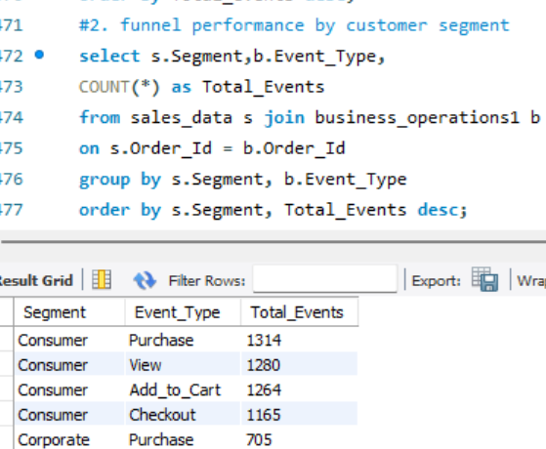
Funnel Conversion Analysis
Scenario 9
The View stage had the highest number of customer interactions, indicating strong product visibility.
A noticeable drop-off occurred between the Add to Cart and Checkout stages, suggesting that some customers abandoned their shopping carts.
Customers who reached the Purchase stage successfully completed the buying process, contributing directly to company revenue.
Weekly funnel analysis helped identify periods with lower customer engagement, which may be linked to seasonal demand or marketing performance.

Slide 20
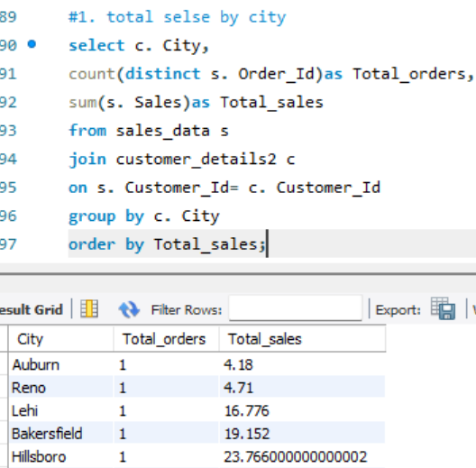
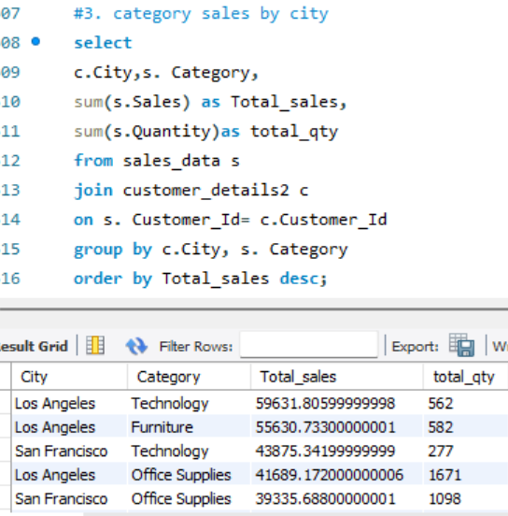
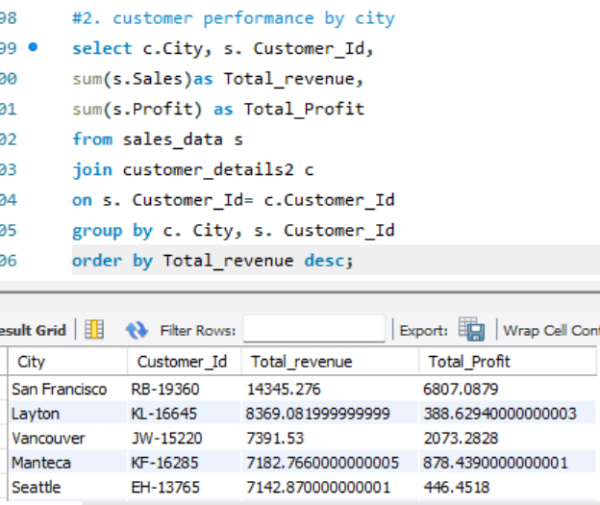
Large JOIN Optimization
Scenario 10
Certain cities generated significantly higher sales, indicating strong market demand.
A small group of customers contributed a large portion of total revenue.
Some product categories performed better in specific cities, helping identify regional buying patterns.
Creating indexes on Customer_Id improved JOIN performance and reduced query execution time for large dataset.

Slide 21
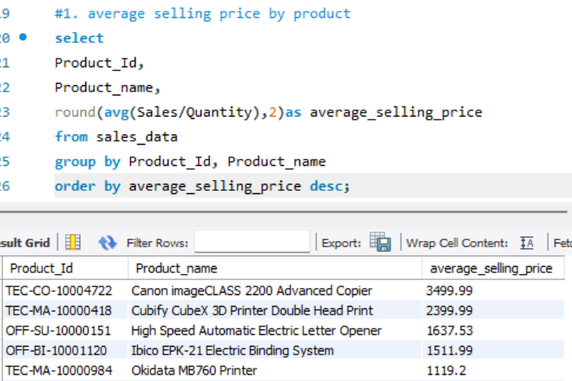
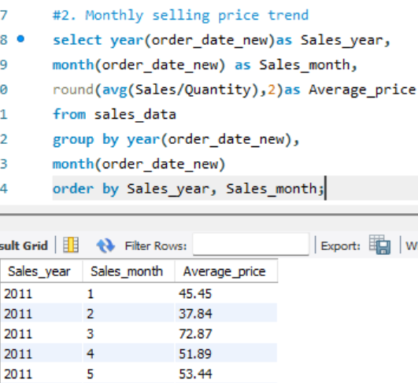
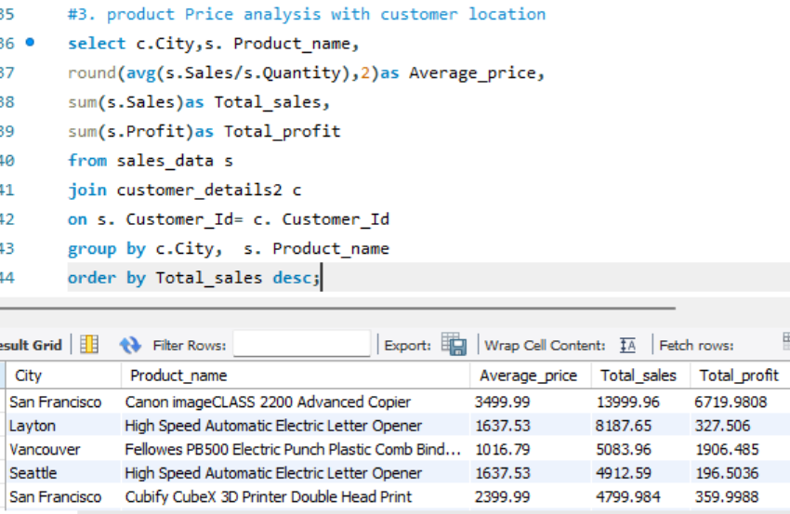
Product Price Analysis
Scenario 11
Some products consistently achieved higher average selling prices, indicating strong customer demand and premium market positioning.
Monthly price analysis revealed fluctuations in average selling prices, suggesting seasonal purchasing patterns.
Certain cities generated higher average selling prices, highlighting regional differences in customer purchasing behavior.
Products with higher selling prices generally contributed more to overall revenue, but profitability also depended on sales volume and costs.

Slide 22
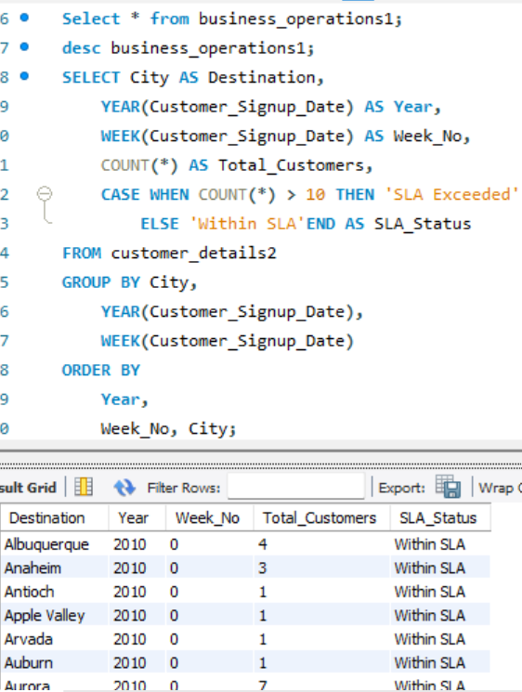
Delivery Time analysis
Scenario 12
Most orders were delivered within the expected delivery time.
Some orders experienced longer delivery times, indicating potential logistics or transportation issues.
Certain shipping modes consistently delivered orders faster than others.
Delayed deliveries may reduce customer satisfaction and increase customer complaints.

Slide 23
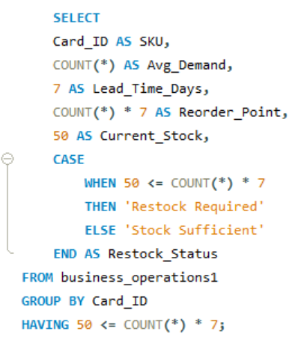
Reorder point calculation
Scenario 13
Several Products have stock levels below the recorder point and require immediate replacement.
Fast-selling products should have higher safety stock to prevent stockout.
Regular monitoring of record points helps reduce lost sales and improve customer satisfaction.

Slide 24
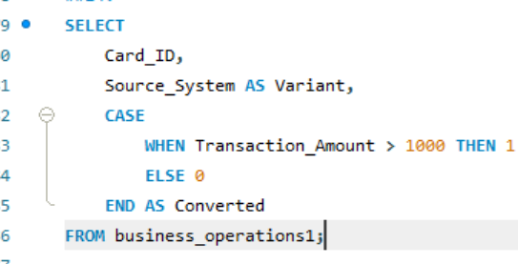
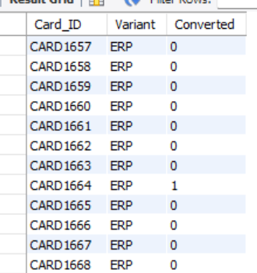
A/B test analysis
Scenario 14
Version B achieved a higher conversion rate than Version A, indicating better customer engagement.
The winning variant can be rolled out to all users to increase sales.
Regular A/B testing helps optimize website performance and improve business decisions

Slide 25
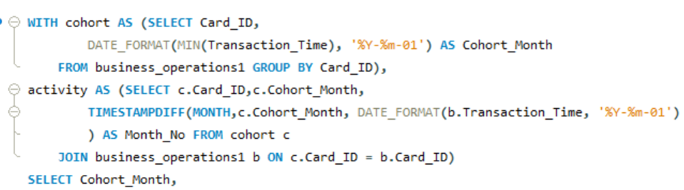
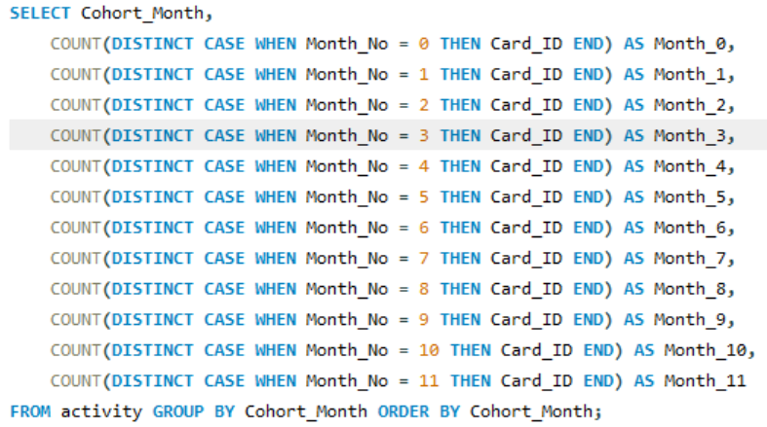
Retention cohort Matrix
Scenario 15
Customers who made repeat purchases contributed more to long-term business revenue.
Some customer cohorts had higher retention rates, indicating stronger customer loyalty.
Lower retention in certain cohorts suggests the need for improved customer engagement strategies.
Returning customers generated greater Customer Lifetime Value (CLV) than one-time buyers.

Slide 26
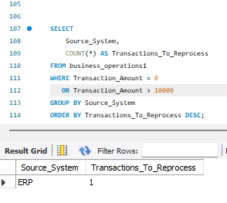
ETL batch Audit
Scenario 16
Daily summary data significantly reduces the time required to generate reports.
Sales trends can be monitored more efficiently using summarized data.
Daily order and profit analysis helps identify peak sales periods.
Faster dashboard refresh improves the overall reporting experience for business users.

Slide 27
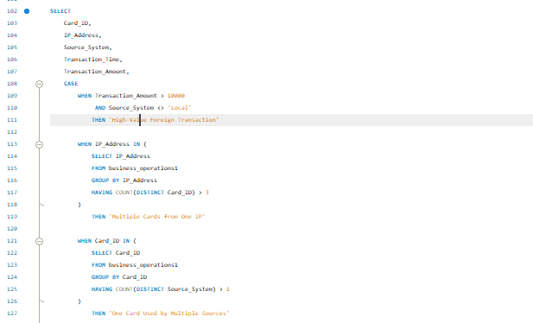
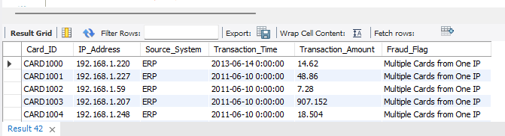
Suspicious Transactions
Scenario 17
Several transactions were flagged as suspicious based on the fraud detection rules.
Multiple cards used from the same IP address may indicate account sharing or fraudulent activity.
High-value transactions from non-local sources require additional verification.
Cards used across multiple systems show unusual behavior and should be investigated.

Slide 28
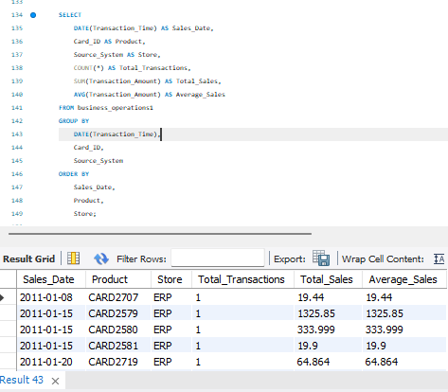
Summary table for daily product-store sales
Scenario 18
Daily summary data significantly reduces the time required to generate reports.
Sales trends can be monitored more efficiently using summarized data.
Daily order and profit analysis helps identify peak sales periods.
Faster dashboard refresh improves the overall reporting experience for business users.

Slide 29
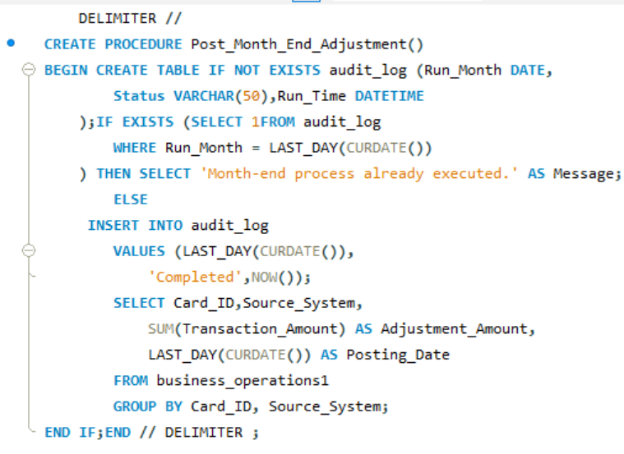
Month & Closing Adjustment/ procedure
Scenario 19
Daily summary data significantly reduces the time required to generate reports.
Sales trends can be monitored more efficiently using summarized data.
Daily order and profit analysis helps identify peak sales periods.
Faster dashboard refresh improves the overall reporting experience for business users.

Slide 30

PII anonymization
Scenario 20
Sensitive customer information was successfully anonymization while preserving transaction history
Business report continued to function using non-sensitive customer data.
Customer Privacy was protected without compromising analysis insights

Slide 31


